Slide 1
WIND POWER FORECASTING USING DEEP LEARNING
Guided by
Dr. C. N. Bhende
Presented by
Pawan Kumar Saini
(16EE01042)

Slide 2
Outlines
Introduction
Effective dependency parameters
Simulation block diagram
Mathematic of LSTM model
Wind Power Prediction using LSTM
Front end designing
Conclusion
References

Slide 3
Introduction
The wind energy depends on the speed of the wind that is not very linear.
Wind speed follows a certain pattern over time.
This time-series pattern is used to predict power.
Reliable short-term wind forecasting plays a very significant and important role in wind power conversion systems.
Wind power prediction plays a major role in various industries due to much consumption of power.
There are three traditional methods in wind power forecasting that are physical modeling, mathematical methods and computational techniques.

Slide 4
Dependency Parameters
Wind power depend on following parameter:
Wind speed
Height of tower and installation
Density of air
Temperature
Pressure
Rotor diameter
Electrical and Mechanical efficiency
Power available in wind
PW = 0.5*ῥA(V^3)
Pw = Available power in air(kW),
ῥ = air mass density (kg/m3),
A = is the swept blade area (m2),
V = is the speed of the wind (m/s).
Pout = Cp*ηm*ηe*Pw
Pout=output power from wind generator
Cp = Power coefficient
ηm = Mechanical efficiency, ηe = Electrical efficiency

Slide 5
Simulation And Plots

Slide 6
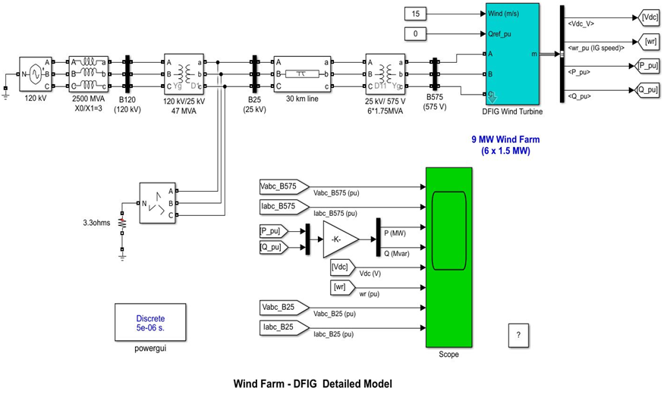

Slide 7
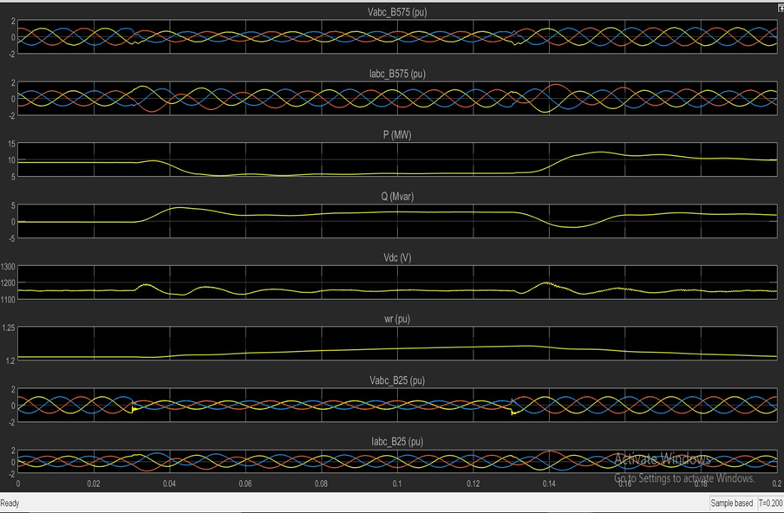

Slide 8
Deep Learning Algorithm for Power Prediction

Slide 9
LSTM(Long Short Term Memory) Model
Long short-term memory (LSTM) is an artificial neural network (ANN) architecture.
LSTM has feedback connections and has standard feedforward neural networks.
LSTM units can be trained in a supervised fashion, on a set of training sequences.
LSTM use past remember memory or past input and ouputs for predicting the new result.
Network consisting of three hidden layers is built.
1. Input layer
2. Hidden layer
3. Output layer

Slide 10
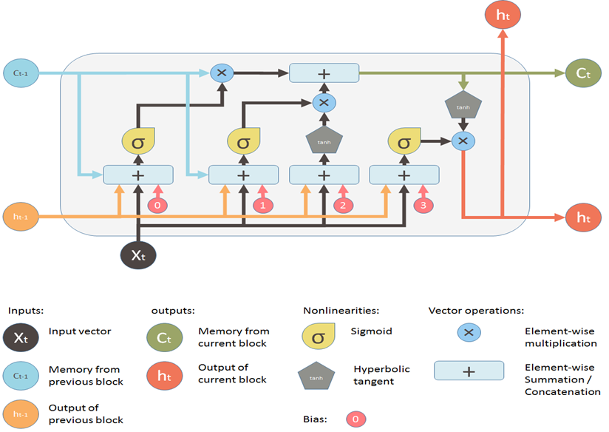

Slide 11
Mathematic of LSTM
Input gate: it = g(Wxi xt +Whist -1 + bi )
Forget gate: ft = g(Wxf xt +Whf st -1+ bf )
Output gate: o = g(Wx +W s + b )
Input transform: c _ in = tanh(W x +W s + b)
State update: ct = ft × ct -1 + it × c _ int st = ot × tanh(ct )
Predicted output: o(t +1) = F (o(t), o(t -1), … , o(t - n), x(t +1), x(t), x(t -1), x(t - n))
Where:
o(t+1) o(t), o(t-1), …, o(t-n) are is the predicted wind power
x(t+1), x(t), …, x(t-n) is current and past observed wind power.

Slide 12
Power Prediction Using LSTM

Slide 13
Three Experiment done using LSTM
Power estimation
Future Power Prediction - Element wise
Future Power Predection - Frame wise

Slide 14
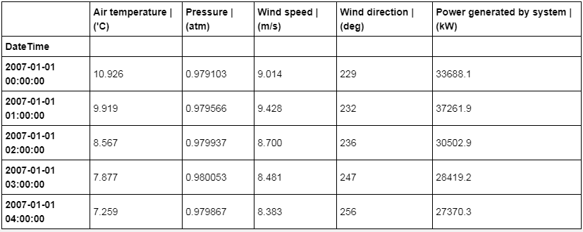
Data-set used in project

Slide 15
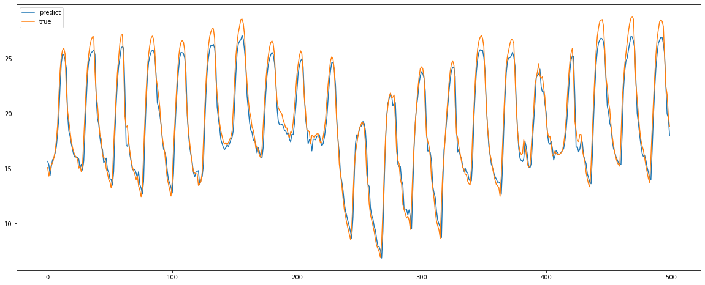
Exp. 1: 70-30 train-test data division
Root mean square error (RMSE) = 1.242
Variance = 0.984

Slide 16
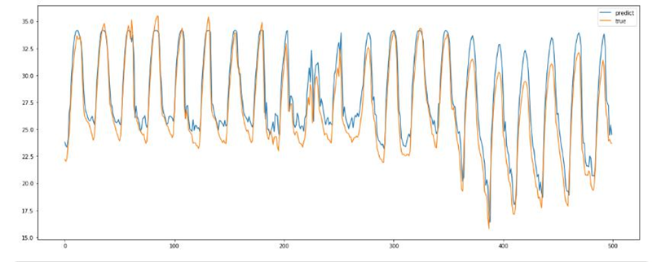
Exp. 2: 60-40 train-test data division
Root mean square error (RMSE) = 1.667
Variance = 0.969

Slide 17
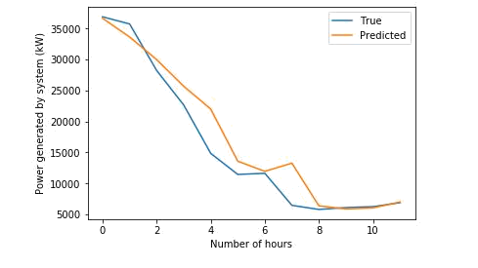
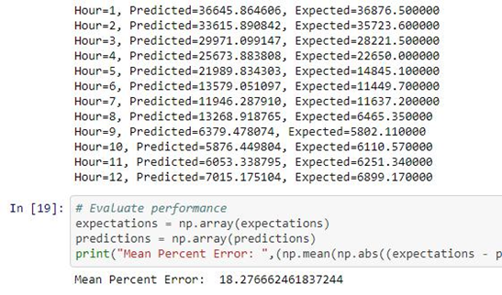
Power Predection
Exp. 1. 12 hours Prediction
Mean percent error 18.28%

Slide 18
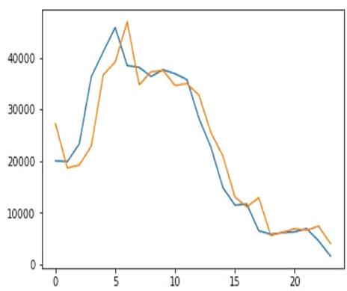
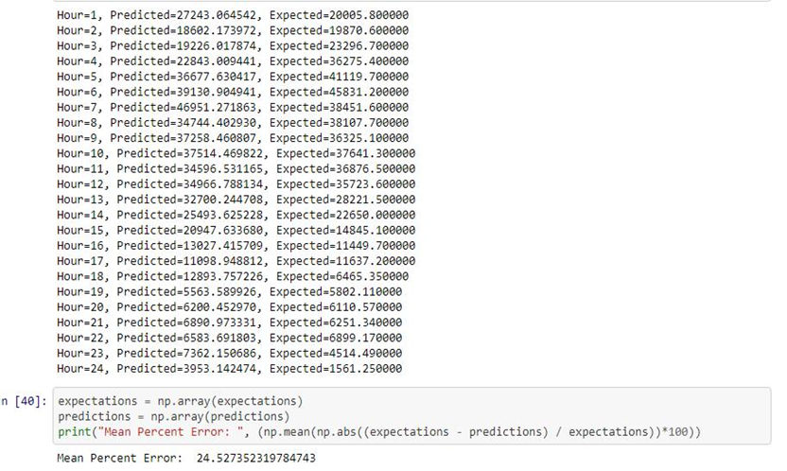
Exp. 2:- 24 hours Prediction
Mean percent error =24.53%

Slide 19
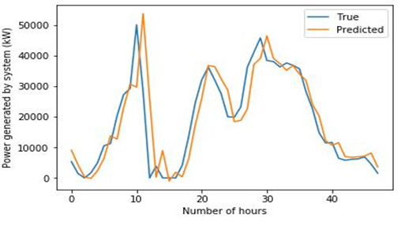
Exp. 3:- 48 hours Prediction
Mean percent error =39.47%

Slide 20
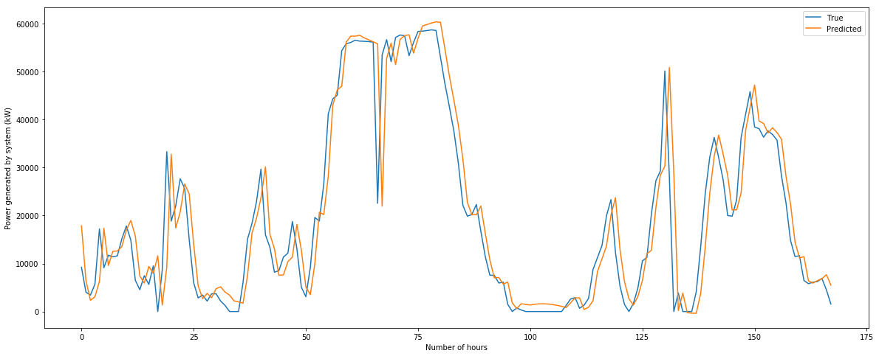
Exp. 4:- 1 week Prediction
Mean percent error =44.74%

Slide 21
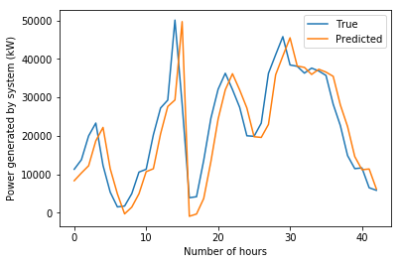
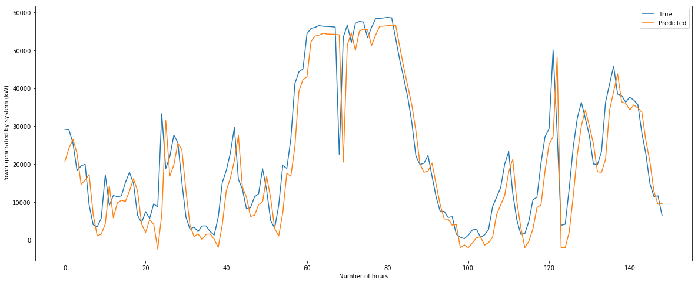
Exp. 5:- 48 hours and 1 Week Prediction with model Optimization
Mean percent error =30.766%
Mean percent error =38.634%

Slide 22
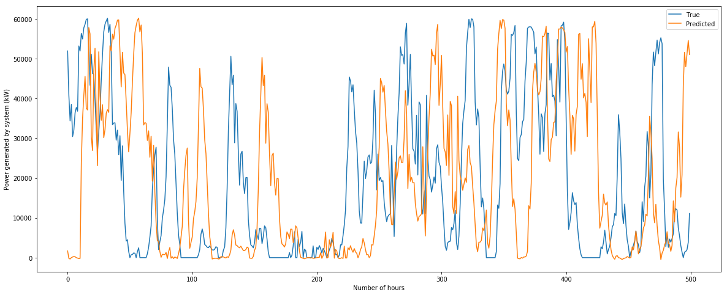
Exp. 1:- 24 hours Prediction
Power Prediction For Next Kth Time Interval at a Time
Mean percent error =35.143%

Slide 23
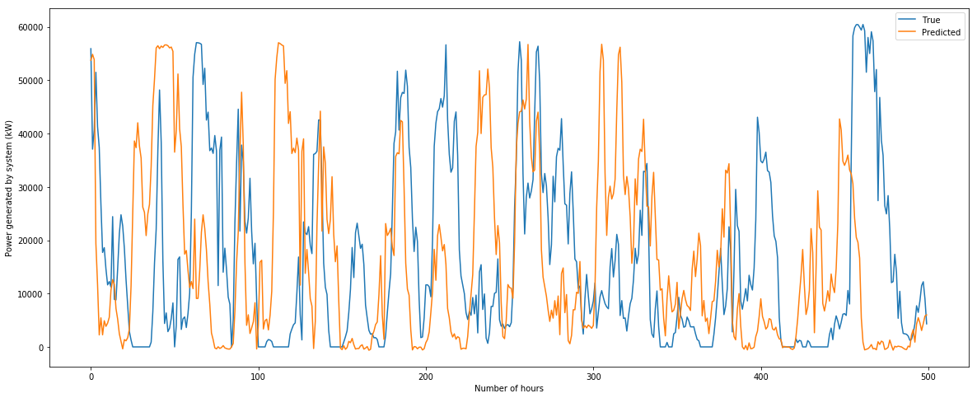
Exp. 2:- 48 hours Prediction
Mean percent error =46.716%

Slide 24
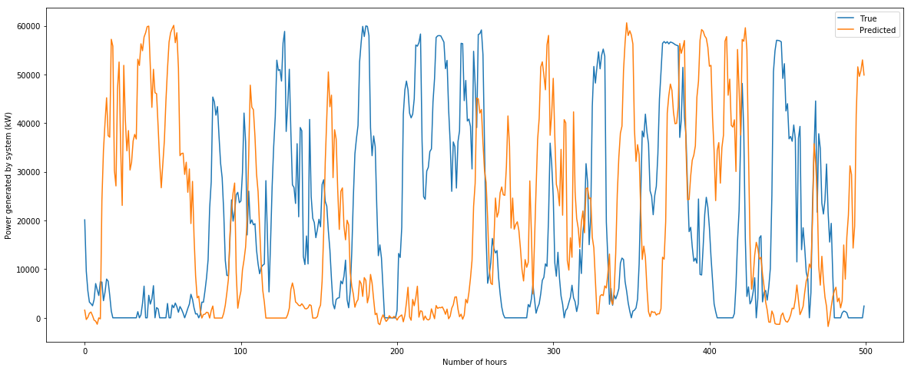
Exp. 3:- 1 week Prediction
Mean percent error =51.473%

Slide 25
Front End Design
Front end design(GUI) is Created using tkinter library (Python).
To create a GUI using tkinter:
1. Importing the module – tkinter
2. Create the main window (container)
3. Add any number of widgets to the main window
4. Apply the event Trigger on the widgets.

Slide 26
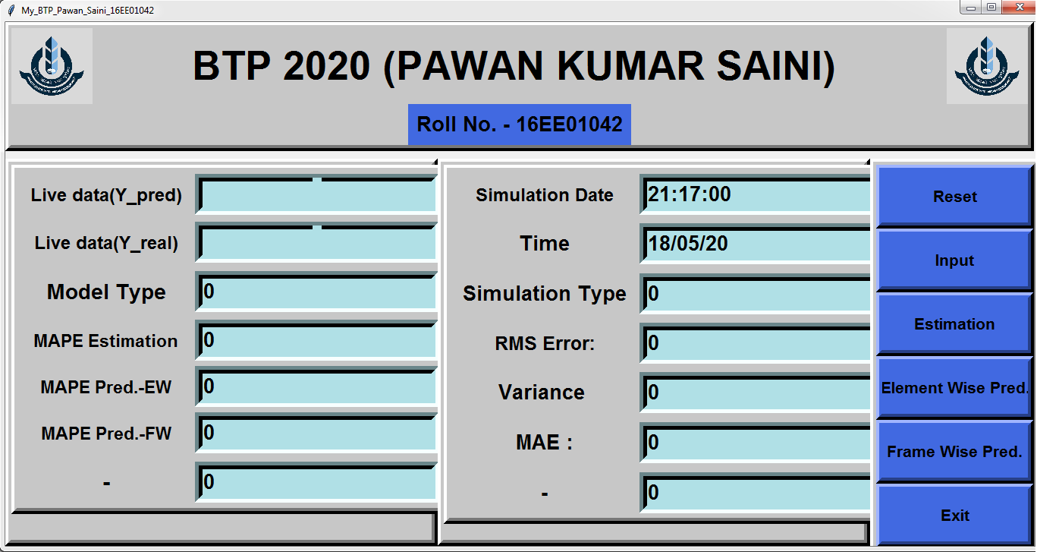

Slide 27
Conclusion
LSTM is able to get the pattern in the long term data i.e. seasonal and annual changes in the power generated by the system.
For wind speed less than 4 m/s the power generated by the system is zero.
Performance can be increased by another neural network method.

Slide 28
References
2016 IEEE PES Asia-Pacific Power and Energy Conference - Xi'an – China “Short-Term Prediction of Wind Power Based on Deep Learning-Long Short-Term Memory” Qu Xiaoyun, Kang Xiaoning, Zhang Chao, Jiang Shuai, Ma Xiuda Shaanxi Key Laboratory of Smart Grid, Xi'an Jiaotong University
“A Combined Approach for Very Short Term Wind Power Probability Forecast” - Yubo Tao, Yafei Zhang, Bo Chen and Jing Shi, Member, IEEE
https://www.analyticsvidhya.com/blog/2017/12/fundamentals-of-deep-learning introduction-to-lstm/
https://www.kaggle.com/jphoon/bitcoin-time-series-prediction-with-lstm
https://machinelearningmastery.com/time-series-forecasting-long-short-term-memory-network-python/
https://en.wikipedia.org/wiki/Long_short-term_memory

Slide 29
Thank You

